Slide 1
Capstone Engagement
Assessment, Analysis, and Hardening of a Vulnerable System

Slide 2
Table of Contents
This document contains the following sections:
01
Network Topology
02
Red Team: Security Assessment
03
Blue Team: Log Analysis and Attack Characterization
Hardening: Proposed Alarms and Mitigation Strategies
04

Slide 3
Network Topology
‹#›

Slide 4
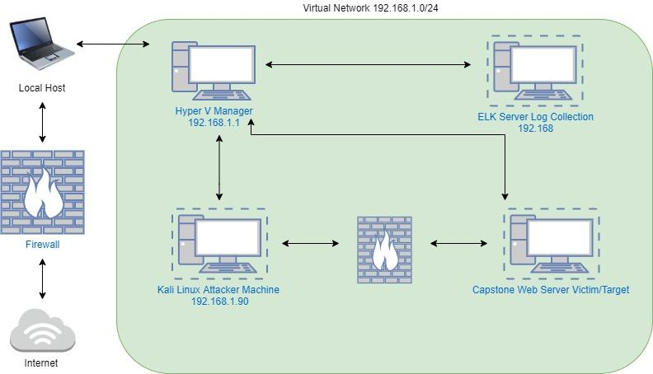
Network Topology
[Insert Here]
Use draw.io to create a diagram of the network.
Add your diagram to this slide and fill out the data in the sidebar.
Network
Address Range: 192.168.1.0/24
Netmask: 255.255.255.0
Gateway: 192.168.1.1
Machines
IPv4: 192.168.1.1
OS: Windows
Hostname: ML-REFVM-684427
IPv4: 192.168.1.90
OS: Linux
Hostname: Kali
IPv4: 192.168.1.100
OS: Linux
Hostname: ELK
IPv4: 192.168.1.105
OS: Linux
Hostname: Capstone

Slide 5

Red Team
Security Assessment
‹#›

Slide 6
Recon: Describing the Target
Nmap identified the following hosts on the network:
Hostname | IP Address | Role on Network
Hyper V Manager | 192.168.1.1 | Local Host Machine that runs virtualization software for virtual machines or servers
ELK | 192.168.1.100 | Server for log collection
Kali | 192.168.1.8 | Attacker VM running Kali Linux
Capstone | 192.168.1.105 | Victim/ Target using Apache Web Server

Slide 7
Vulnerability Assessment
The assessment uncovered the following critical vulnerabilities in the target:
Vulnerability | Description | Impact
Open TCP Port 80 | Poorly configured and unsecured HTTP, allowed the exploitation of Capstone(Target machine) server and sensitive data. | This allows anyone with internet using a web browser access to the Capstone server. There they can access to hidden files, directories, usernames and sensitive company data.
Inadequate login/password policies & practices: CWE-307 | No account lockout for failed number of login attempts. -Only single factor authentication used for logins. | Capstone web server is accessible and open to exploitation by those who can obtain passwords via brute force attacks or by password cracking methods.
php Reverse Shell Infiltratration: CWE-98 | The CentOs application requires updating/patching as it is out of date, leaving the server exposed to exploitation. | This allows an attacker to use Remote File Intrusion to execute shell command to gain full access to the server.

Slide 8
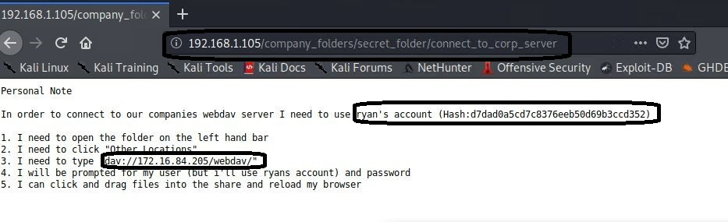
Traversal: [Relative Path]
01
Tools & Processes
We used the Nmap tool to choose our target by viewing the open ports and services on the network. We used a path traversal technique to look for hidden web objects which showed the path.
http://192.168.1.105/company_folders/secret_folder/
03
Achievements
Using this path tool granted access to two hidden directories within the web server. The secret folders were labeled as “secret_folder” and “webdav”.
02

Slide 9
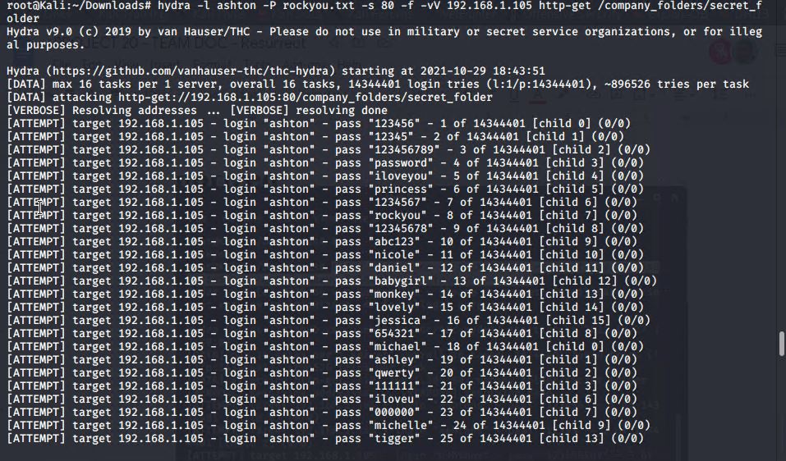
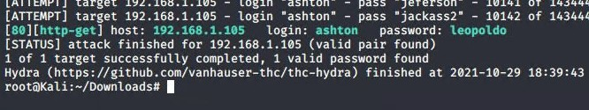
Brute Force: [Excessive Authentication Attempts]
Tools & Processes
The Hydra program was used to conduct a brute force attack to obtain the credentials for the ‘secret_folder’ directory.
01
03
02
Achievements
The Hydra command used in the screenshot was able to produced the username:credentials ‘ashton:leopoldo’ which granted access to the secret_folder.

Slide 10
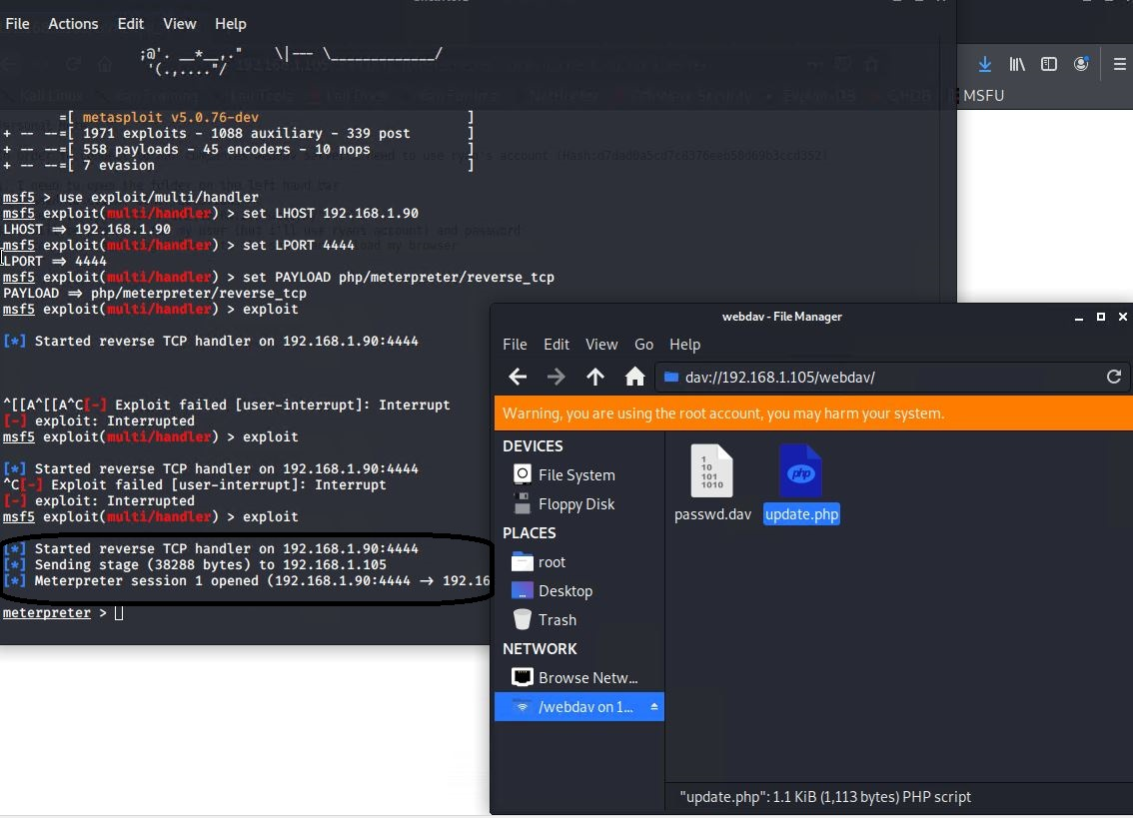
Improper Control of Filenames in PHP Program
01
Tools & Processes
We managed to upload a reverse shell code without restrictions from the server before we it was used. Once meterpreter was configured to listen to port 4444 the attack showed to be successful.
03
Achievements
Once the code was executed it provided access to the target server using the reverse shell.
02

Slide 11

Blue Team
Log Analysis and Attack Characterization
‹#›

Slide 12

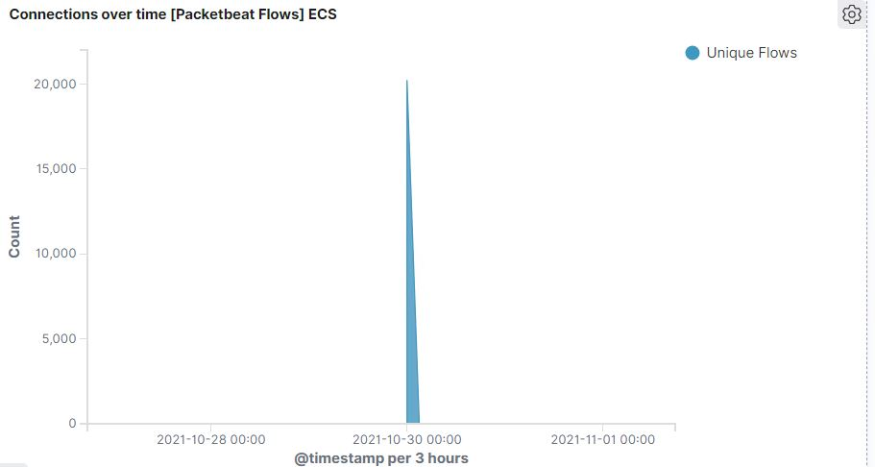
Analysis: Identifying the Port Scan
The port scan occurred at approximately 18:00:00
(32,685) hits were sent from the attacker machine 192.168.1.90

Slide 13
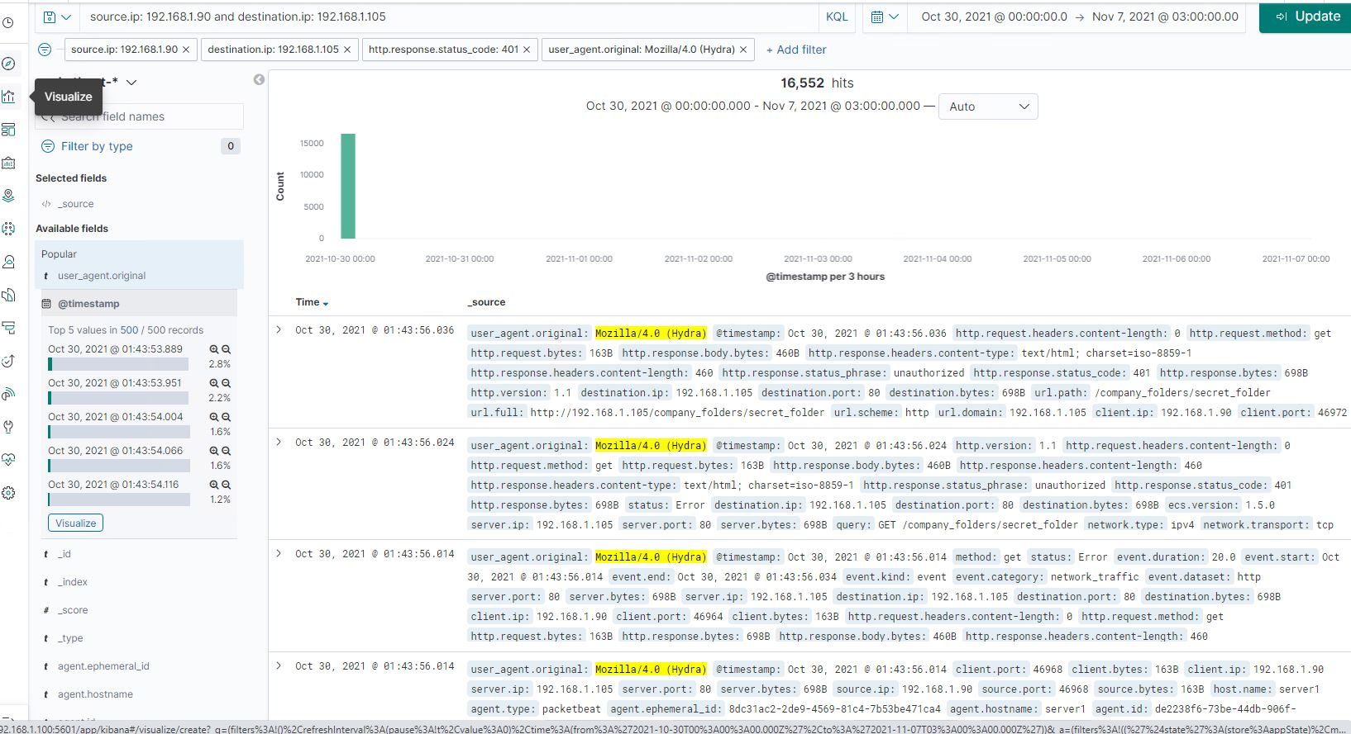
Analysis: Identifying the Port Scan Cont.
The screenshot below indicates, we can see the total number of requests (16,552) scanning all different ports with port 80, & 443 excluded.
[Insert Here]
Include a screenshot of Kibana logs depicting the port scan.

Slide 14
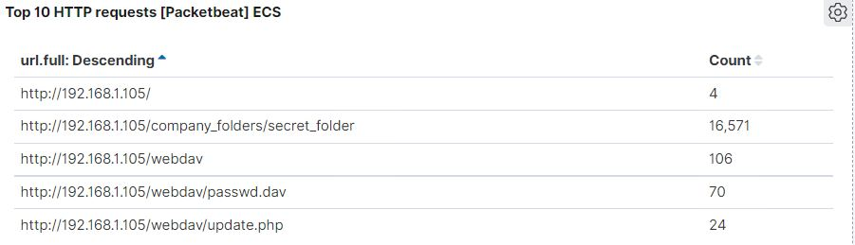
Analysis: Finding the Request for the Hidden Directory
The screenshot shows what we observed during the attack which started at 18:00:00 with 16,571 requests.
The top three hits fr directories and files requested were:
http://192.168.1.105/company_folder/secret_folder
http://192.168.1.105/company_folder/webdav
http://192.168.1.105/company_folder/webdav/passwd.dav

Slide 15
Analysis: Uncovering the Brute Force Attack
Approx. 16,570 requests were made during the attack.
After (16,552) requests for access to the password protected secret_folder only (4) were successful considering the file inside the directory
[Insert Here]
Include a screenshot of Kibana logs depicting the brute force attack.

Slide 16
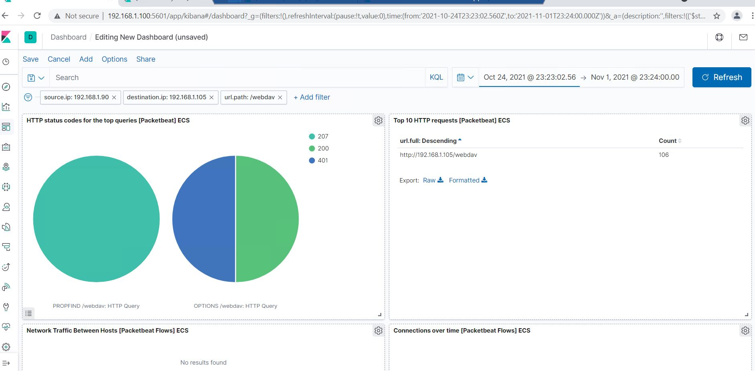
Analysis: Finding the WebDAV Connection
The passwd.dav file was requested 70 times.
The Update.php file was requested 24 times.
106 total requests were made from webdav directory.
[Insert Here]
Add a screenshot of Kibana logs depicting the WebDAV connection.

Slide 17
Blue Team
Proposed Alarms and Mitigation Strategies
‹#›

Slide 18
Mitigation: Blocking the Port Scan
What kind of alarm can be set to detect future port scans?
Develop a filter that will activate if a single source IP is attempting to connect to different ports with anything > 100 requests per minute.
What threshold would you set to activate this alarm?
If a single IP sends more 100 requests per minute for more than 3 minutes with attempts to access a closed port activate the filter
What configurations can be set on the host to mitigate port scans?
Install local firewall or Physical firewall device such as a SonicWall that can detect port scans.
Develop a Whitelist of Ip addresses for the network.
Describe the solution. If possible, provide required command lines.
Filter traffic from an IP address that triggers an alert with IPS (Intrusion Prevention System) which will deter port scans.

Slide 19
Mitigation: Finding the Request for the Hidden Directory
What kind of alarm can be set to detect future unauthorized access?
Allow Whitelisted IP’s
Set alerts that are triggered by attempted access by IP’s not on the the whitelists.
What threshold would you set to activate this alarm?
The threshold for this alarm to trigger would be 1. The alarm would notify if 1 machine attempted access.
What configuration can be set on the host to block unwanted access?
Ensure the directory does not exist on the server.
Describe the solution. If possible, provide required command lines.
rmdir -r
The command above ca used to remove all files and directories from the server

Slide 20
Mitigation: Preventing Brute Force Attacks
What kind of alarm can be set to detect future brute force attacks?
Set an alert that is triggered when a 401 unauthorized result is returned from the server over the calculated threshold.
What threshold would you set to activate this alarm?
Set an account lockout after 5 failed login attempts in a hour time period with an hour cooldown after the lockout has occurred.
What configuration can be set on the host to block brute force attacks?
Limit failed login attempts
Set limits to logins on whitelisted IP addresses.
Describe the solution. If possible, provide the required command line(s).
Configure Account Policy on server limiting failed login attempts.

Slide 21
Mitigation: Detecting the WebDAV Connection
What kind of alarm can be set to detect future access to this directory?
Set an alert for any IP not on the Whitelist that attempts to access the directory.
Whitelist all IP’s in the server range
What threshold would you set to activate this alarm?
The threshold should be one. Any attempted access should trigger the alarm.
What configuration can be set on the host to control access?
Connections to the shared folder should not be accessible from the web due to the non adherence to the firewalls rule.
Describe the solution. If possible, provide the required command line(s).
Block/Lock port 80,443, and 4444

Slide 22
Mitigation: Identifying Reverse Shell Uploads
What kind of alarm can be set to detect future file uploads?
Set an alert for when any .php file uploaded.
Set firewall or SZR to block traffic to the “shared folder” on Ports 80,443,4444
What threshold would you set to activate this alarm?
Any traffic on those ports should trigger an alarm.
What configuration can be set on the host to block file uploads?
Remove the ability to upload files from a web server. Uploads should only be from a local source.
Describe the solution. If possible, provide the required command line.
Block/Lock port 80,443, and 4444

Slide 23
Interview Question:
https://docs.google.com/document/d/1o6Pzx-OqTlts_ZBvbeX1y_IGPdHYrRUV1lSM0RKBb58/edit?usp=sharing

